Slide 1


Compiler Construction
Lecture 05

Slide 2
Chapter 03
Lexical Analyzer

Slide 3
Objectives
You will learn about;
Unit 5.1 :
  Finite Automata
Unit 5.2 :
  Subset Construction Algorithm
Unit 5.3 :
  Simulations
Unit 5.4 :
  Pattern Matching Based on NFA 's and DFA’s

Slide 4
UNIT 5.1
Home
  Finite Automata

Slide 5
Finite Automata
We shall now discover how Lex turns its input program into a lexical analyzer. At the heart of the transition is the formalism known as finite automata. These are essentially graphs, like transition diagrams, with a few differences:
1. Finite automata are recognizers; they simply say "yes" or "no" about each
possible input string.

Slide 6
Finite Automata
2. Finite automata come in two flavors:
(a) Nondeterministic finite automata (NFA) have no restrictions on the
labels of their edges. A symbol can label several edges out of the
same state, and E, the empty string, is a possible label.
(b) Deterministic finite automata (DFA) have, for each state, and for
each symbol of its input alphabet exactly one edge with that symbol
leaving that state.
Both deterministic and nondeterministic finite automata are capable of recognizing
the same languages. In fact these languages are exactly the same
languages, called the regular languages, that regular expressions can de~cribe.~

Slide 7
Non Deterministic Finite Automata
A nondeterministic finite automaton (NFA) consists of:
1. A finite set of states S.
2. A set of input symbols C, the input alphabet. We assume that E, which
stands for the empty string, is never a member of C.
3. A transition function that gives, for each state, and for each symbol in
C U (E) a set of next states.
4. A state so from S that is distinguished as the start state (or initial state).
5. A set of states F, a subset of S, that is distinguished as the accepting
states (or final states).

Slide 8
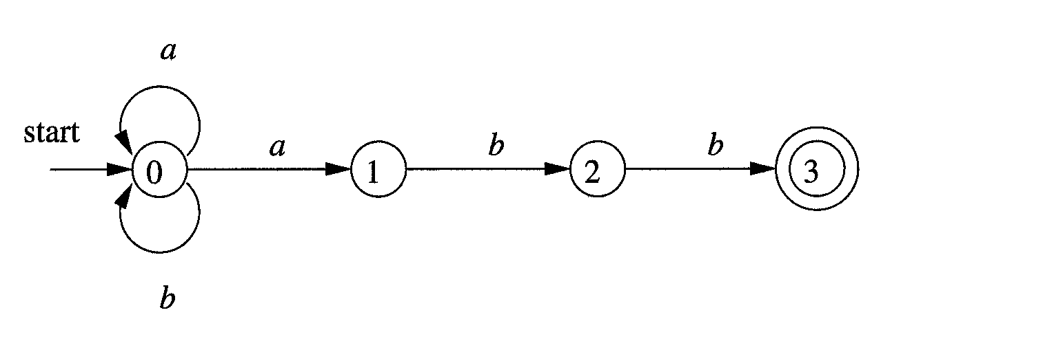
Examples NFA
NFA recognizing the language of regular expression (a|b)*abb

Slide 9
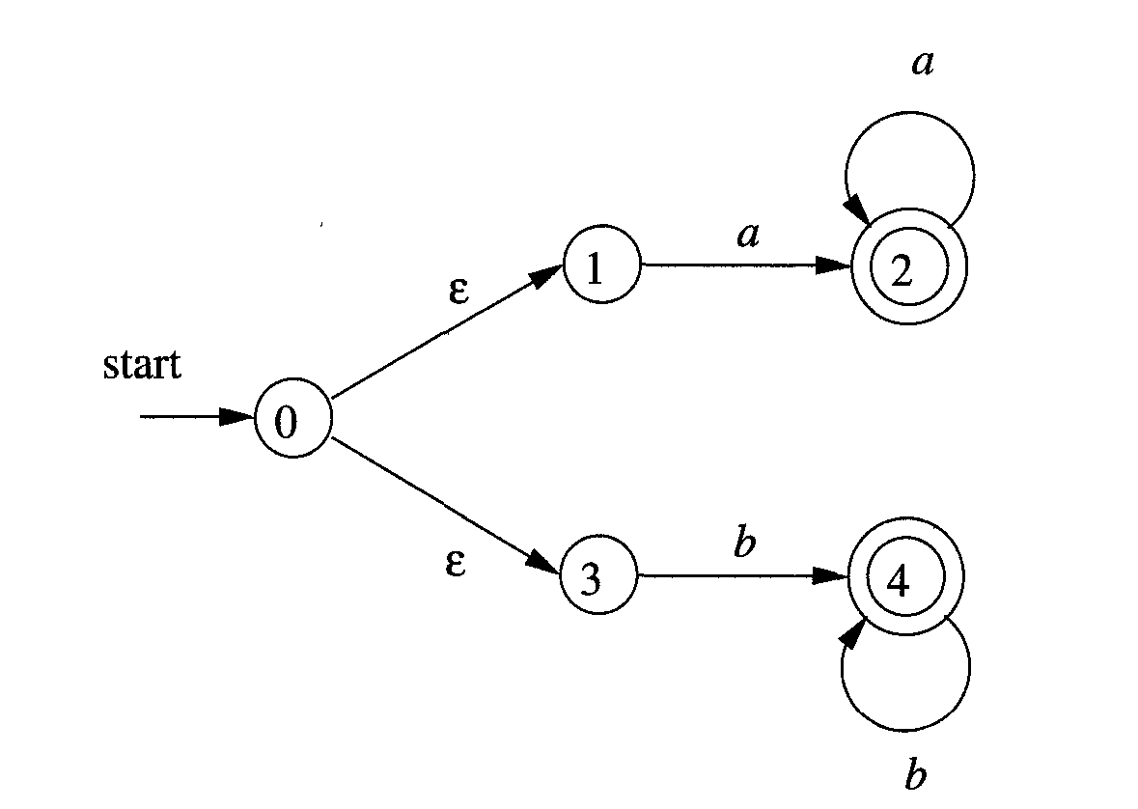
Examples NFA
NFA recognizing the language of regular expression aa* | bb*

Slide 10
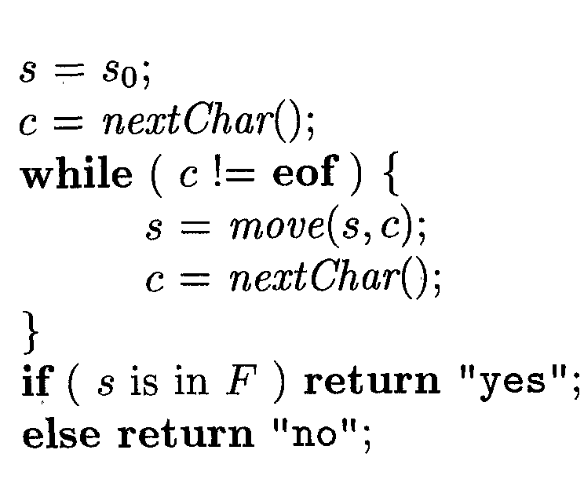
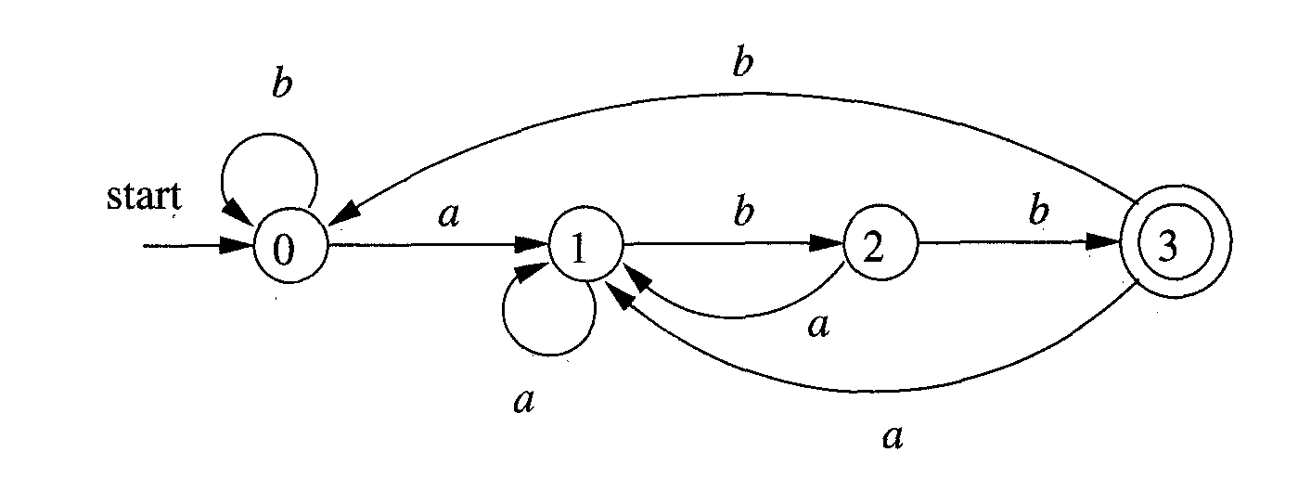
Simulating a DFA
DFA accepting (a|b)*abb

Slide 11
Conversion of NFA to DFA
The algorithm is called subset construction.
In the transition table of an NFA, each entry is a set of states.
In DFA, each entry is a single state.
The general idea behind NFA-to-DFA construction is that each DFA state corresponds to a set of NFA states.
The DFA uses its state to keep track of all possible states the NFA can be in after reading each input symbol.
We will use the following operations.
ε-closure(T):
set of NFA states reachable from some NFA state s in T on ε-transitions alone.

Slide 12
Conversion of NFA to DFA
move(T,a):
set of NFA states to which there is a transition on input a from some NFA state s in set of states T.
Before it sees the first input symbol, NFA can be in
any of the state in the set ε-closure(s₀), where s₀ is the start state of the NFA.
Suppose that exactly the states in set T are reachable from s₀ on a given sequence of input symbols.
Let a be the next input symbol.
On seeing a, the NFA can move to any of the states in the set move(T,a).

Slide 13
Conversion of NFA to DFA
When we allow for ε-transitions, NFA can be in any of the states in
ε-closure(move(T,a))
after seeing a.

Slide 14
UNIT 5.2
Home
  Subset Construction Algorithm

Slide 15
Subset Construction Algorithm
Algorithm:
Input:
NFA N with state set S, alphabet Σ, start state s₀, final states F
Output:
DFA D with state set S’, alphabet Σ, start states
s₀’ = ε-closure(s₀), final states F’, transition table: S’ x Σ → S’
// initially, e-closure(s₀) is the only state in D states S’ and it is unmarked
s₀’ = ε-closure(s₀)
S’ = {s₀’ } (unmarked)

Slide 16
Subset Construction Algorithm
while there is some unmarked state T in S’
mark state T
for all a in Σ do
U = ε-closure( move(T,a) );
if U not already in S’
add U as an unmarked state to S’
Dtran(T,a) = U;
end for
end while
F’:
for each DFA state S
if S contains an NFA final state
mark S as DFA final state

Slide 17
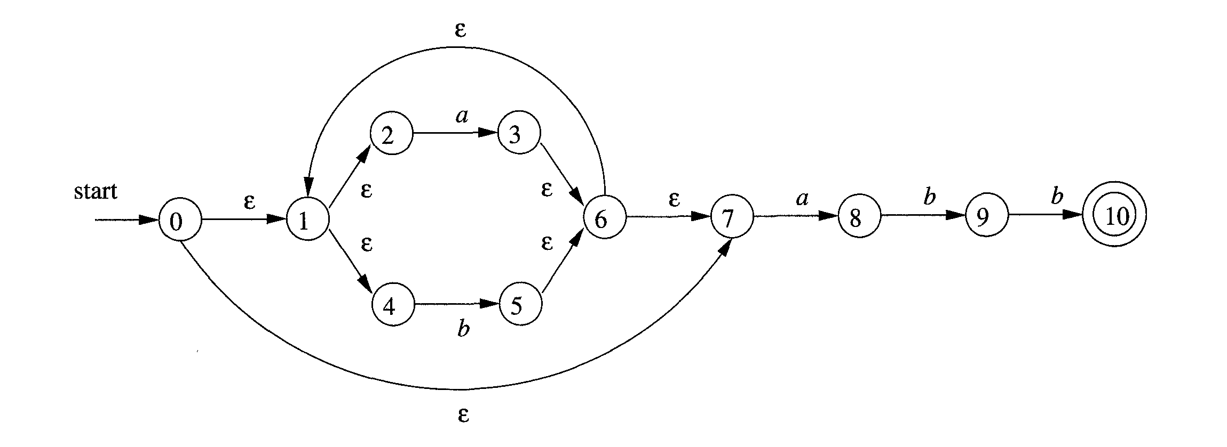
Subset Construction Algorithm
NFA N for (alb)*abb

Slide 18
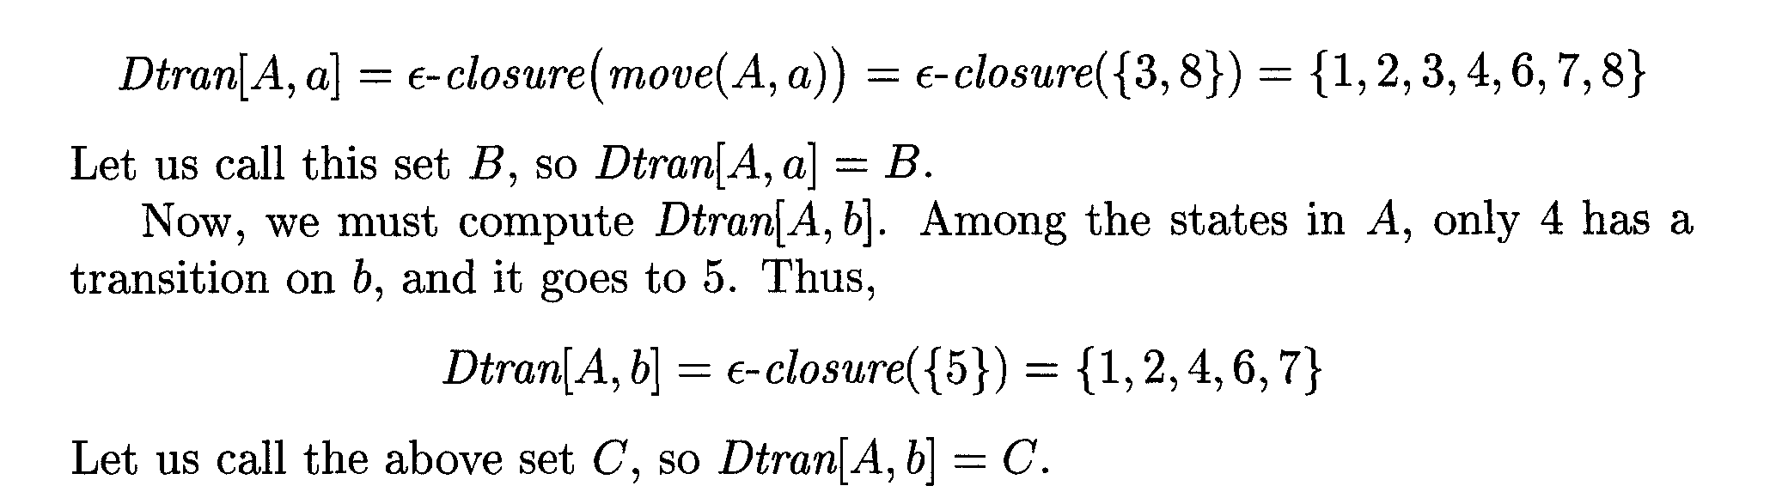
Subset Construction Algorithm

Slide 19
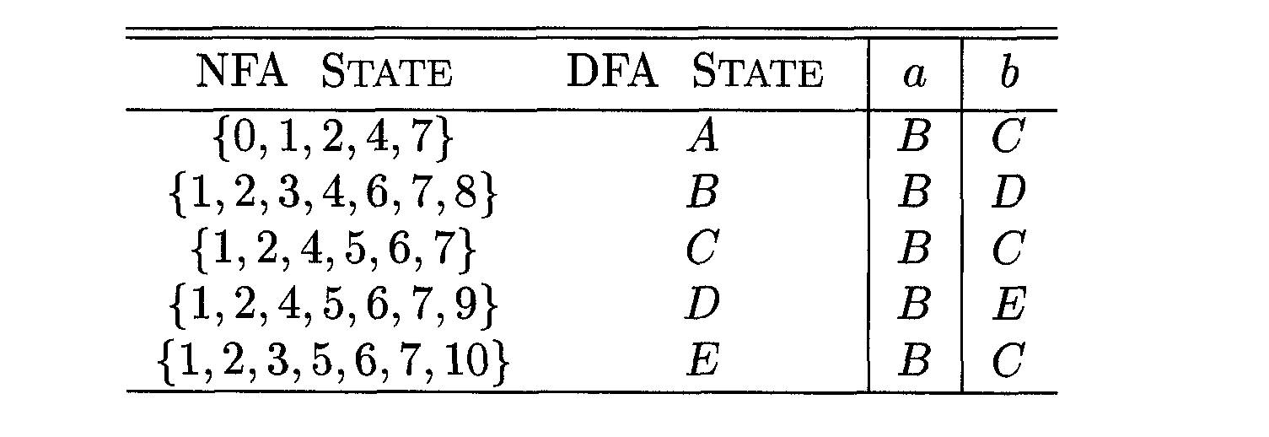
Subset Construction Algorithm
Transition table Dtran for DFA D

Slide 20
UNIT 5.3
Home
  Simulations

Slide 21


Simulation of an NFA
A strategy that has been used in a number of text-editing programs is to construct an NFA from a regular expression and then simulate the NFA.

Slide 22
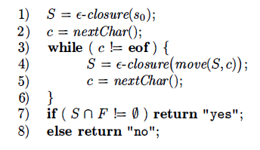
Simulation of an NFA
Algorithm:

Slide 23
Structure of the Generated Analyzer
Its components are:
  A transition table for the automaton.
  Functions that are passed directly through Lex to the output.
  The actions from the input program, which appear as fragments of code to be invoked by the automaton simulator.

Slide 24
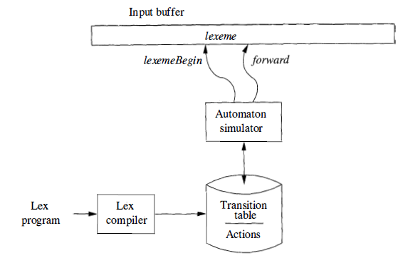
Structure of the Generated Analyzer
Architecture of a lexical analyzer generated by Lex.

Slide 25
Structure of the Generated Analyzer
To construct the automaton, we begin by taking each regular-expression pattern in the Lex program and converting it to an NFA.
We need a single automaton that will recognize lexemes matching any of the patterns in the program.
  So we combine all the NFA's into one by introducing a new start state with ɛ-transitions to each of the start states of the NFA's Ni for pattern Pi

Slide 26
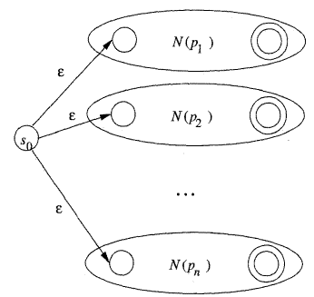
Structure of the Generated Analyzer
An NFA constructed from a Lex program
a { action A₁ for pattern P₁ }
abb { action A₂ for pattern P₂ }
a*b⁺ { action A_{n} for pattern P_{n}}

Slide 27
UNIT 5.4
Home
  Pattern Matching Based on NFA 's and DFA’s

Slide 28
Pattern Matching Based on NFA 's
For pattern based matching the simulator starts reading characters and calculates the set of states.
At some point the input character does not lead to any state or we have reached the eof.
  Since we wish to find the longest lexeme matching the pattern we proceed backwards from the current point (where there was no state) until we reach an accepting state (i.e., the set of NFA states, N-states, contains an accepting N-state).
  Each accepting N-state corresponds to a matched pattern.
  The lex rule is that if a lexeme matches multiple patterns we choose the pattern listed first in the lex-program.

Slide 29
Pattern Matching Based on NFA 's
Ex. Consider three patterns and their associated actions and consider processing the input aaba.
Pattern Actions to perform
a Action A₁
abb Action A₂
a*b⁺ Action A₃

Slide 30
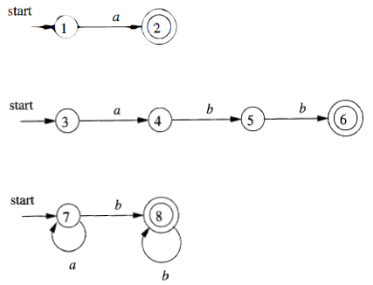
Pattern Matching Based on NFA 's
We begin by constructing the three NFAs.

Slide 31
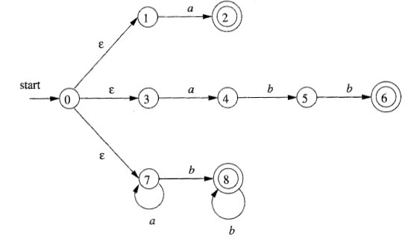
Pattern Matching Based on NFA 's
We introduce a new start state and ε-transitions as discussed in the previous section.

Slide 32
Pattern Matching Based on NFA 's
We start at the ε-closure of the start state, which is {0,1,3,7}.
The first a (remember the input is aaba) takes us to {2,4,7}.
  This includes an accepting state and indeed we have matched the first pattern. However, we do not stop since we may find a longer match.
The next a takes us to {7} and next b takes us to {8}.
The next a fails since there are no a-transitions out of state 8.

Slide 33
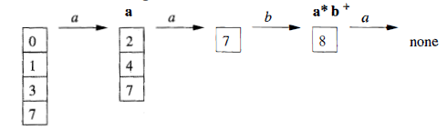
Pattern Matching Based on NFA 's
We are back in {8} and ask if one of these N-states is an accepting state.
Indeed state 8 is accepting for third pattern.
Action3 would now be performed.

Slide 34
Pattern Matching Based on NFA 's
In this section we see an architecture to convert the NFA for all the patterns into an equivalent DFA, using the subset construction mechanism of DFA from NFA.
  Within each DFA state, if there are one or more accepting NFA states, determine the first pattern whose accepting state is represented, and make that pattern the output of the DFA state.

Slide 35
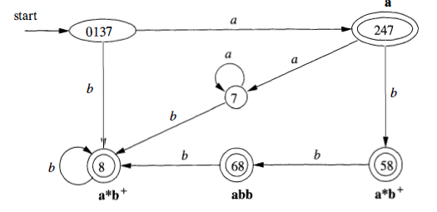
DFA for Lexical Analyzer..
A transition graph for the DFA handling the patterns a, abb and a*b⁺ that is constructed by the subset construction from the NFA.

Slide 36
DFA for Lexical Analyzer…
The accepting states are labeled by the pattern that is matched by that state.
  For instance, the state {6, 8 } has two accepting states, corresponding to patterns abb and a*b⁺.
  Since the former is listed first, that is the pattern associated with state {6,8}.

Slide 37
DFA for Lexical Analyzer…
In the diagram, when there is no NFA state possible, we do not show the edge.
Technically we should show these edges, all of which lead to the same D-state, called the dead state, and corresponds to the empty subset of N-states.

Slide 38
Exercises

Slide 39
Exercises

Slide 40
Thank you

Slide 41
Content Taken From
Compilers Principles, Techniques and Tools by Alfred V. Aho, Ravi Sethi and Jeffry D. Ulman
Web URL:
https://www.thecrazyprogrammer.com/2017/02/lexical-analyzer-in-c.html
https://slideplayer.com/slide/8459297/
https://www.coursehero.com/file/50240138/Lec-6pptx/

